Slide 1

MINI PROJECT
on
VIRTUAL TRIAL ROOM
MINI PROJECT
Virtual trial room
GROUP MEMBERS
RUTUJA SIRSIKAR – VU4F1920009
DIGVIJAY PHUTANE- VU4F1920013
RITESH JAISWAL- VU4F1920014
SHEETAL MUNDE- VU4F1920016
Under the guidance of
Prof. Vedika Avhad

Slide 2
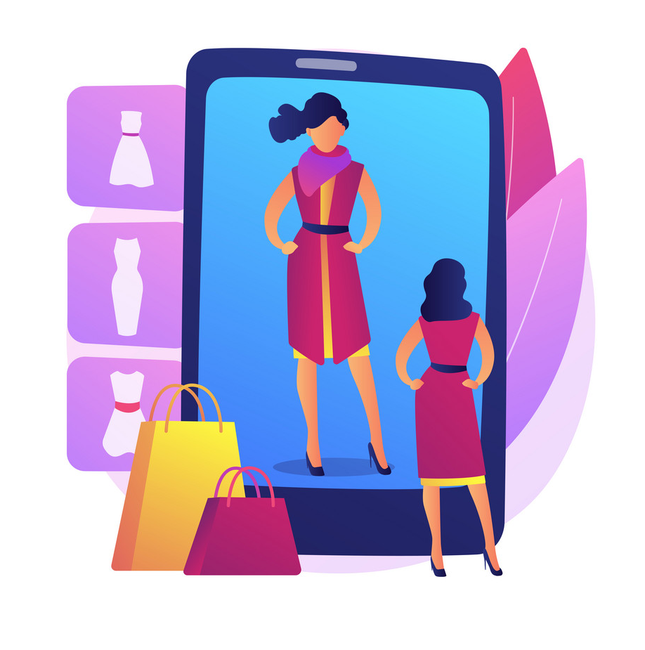
INTRODUCTION
A virtual trial room is a type of technology that allows shoppers to try on items virtually.
Shoppers can virtually try on clothing items or beauty products without physically touching the item itself.
The augmented reality (AR) or artificial intelligence (AI) technology places the item over live imaging of the customer, so they can check the size, style, and fit of a product they’re thinking of buying

Slide 3
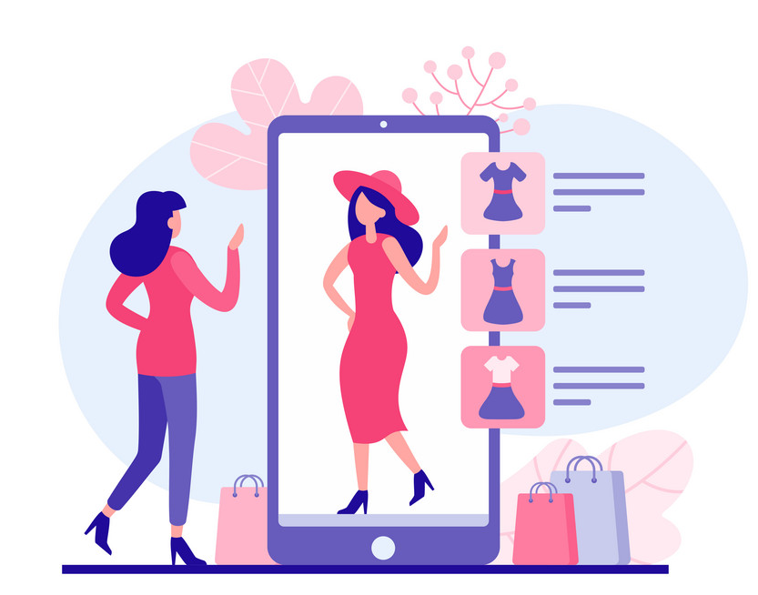
OBJECTIVES
Virtual trial rooms gives customers enhanced experience of shopping by making trying clothes much easier and fun.
Also retailers don’t need to dedicate valuable retail space to changing rooms, instead that space can be used to showcase stock and create visual merchandising displays.
Walking over to physical changing room, and swapping their clothes is inconvenient. Virtual fitting rooms, on the other hand, eliminate all of that. Shoppers can walk over to a virtual mirror and quickly see what the clothing looks like on them.

Slide 4

HOW IT WORKS?
Virtual trial room works on machine learning and artificial intelligence.
In this case, a webcam scans a person’s body and place the product according to size of person.
Then it scans , gives options of products that the shopkeeper has taken to virtual fitting room.

Slide 5
HARDWARE & SOFTWARE REQUIREMENT
SOFTWARE
Visual code studio
Flask 2.1.1
Python 3.10.4
Opencv-python 4.1.2.30
Numpy
HARDWARE
Camera with good resolution.
High configuration system.

Slide 6
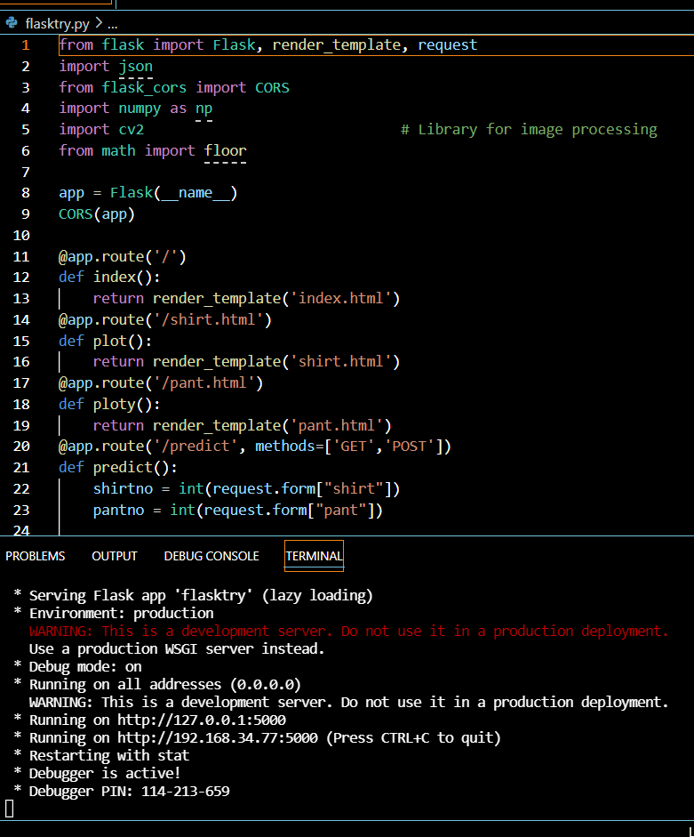
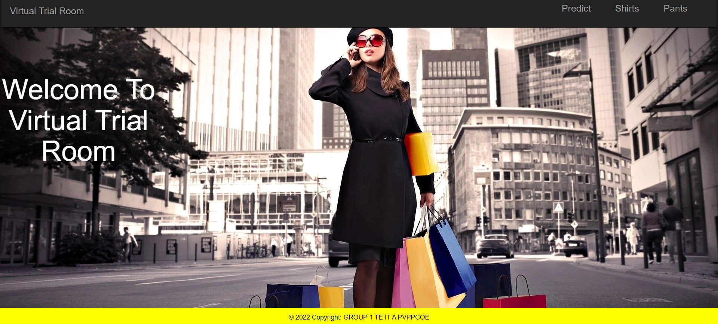
APPLICATION SCREENSHOT

Slide 7
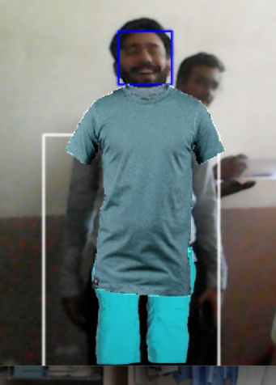
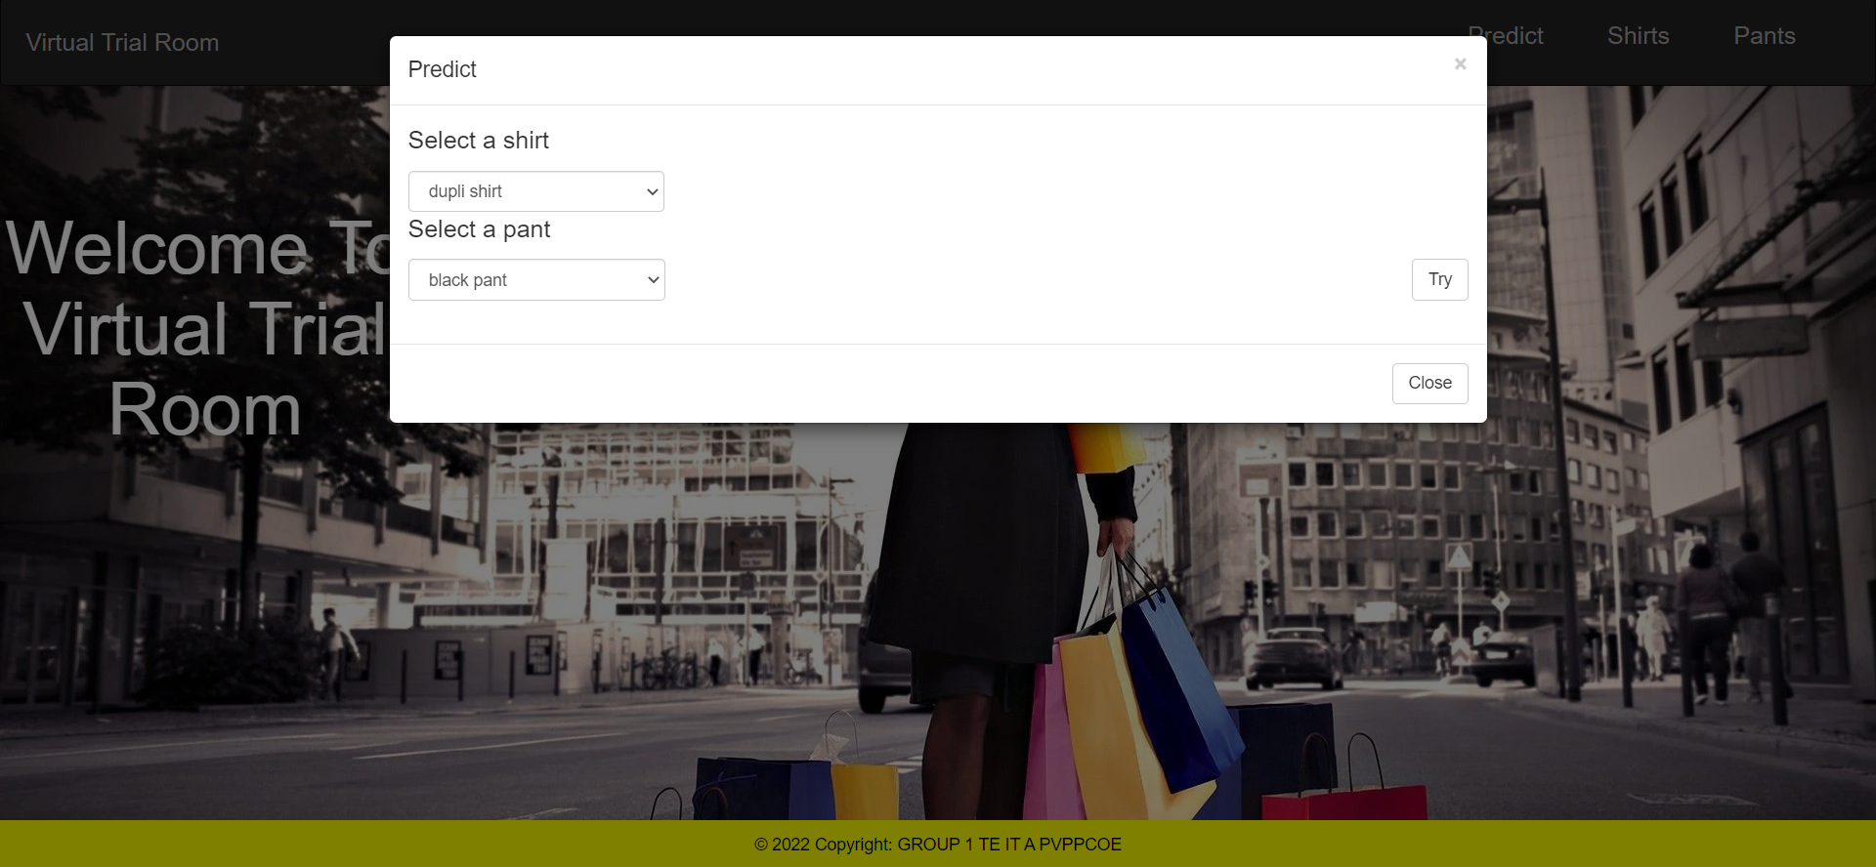
APPLICATION SCREENSHOT

Slide 8
CONCLUSION
Virtual trials room are need for coming generation its time saving and convenient for both shopkeeper and customer it also make shopping fun and much easier.
Also shopkeepers investing in virtual trial rooms have scope can save much space by not having to construct whole trial room
Implementing an machine learning i.e high tech dressing room in business will draw customers’ attention and might positively effect the brand’s image.

Slide 9
REFERENCE
https://www.shopify.com/retail/virtual-fitting-rooms#3
https://www.researchgate.net/publication/337458439_Tendency_to_Use_the_Virtual_Fitting_Room_in_Generation_Y_-_Results_of_Qualitative_Study
https://www.google.com/search?q=advantages+of+virtual+trial+rooms&rlz=1C1SQJL_enIN886IN886&oq=advantages+of+virtual+trial+rooms&aqs=chrome..69i57j0i22i30j0i390l3.12862j0j7&sourceid=chrome&ie=UTF-8
https://4experience.co/virtual-fitting-rooms-how-can-they-benefit-your-business/

Slide 10
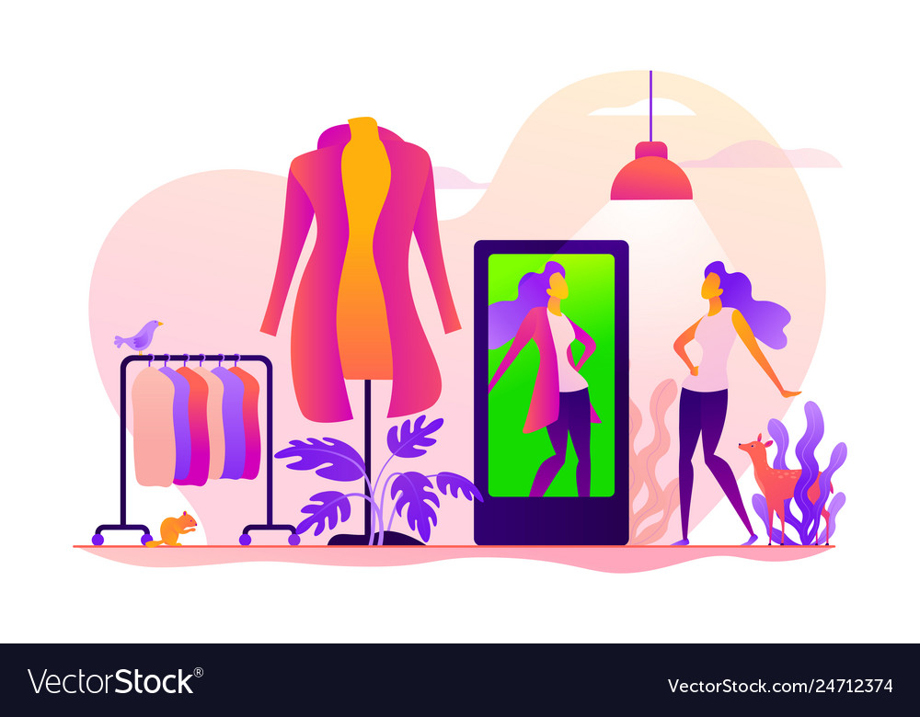
THANK YOU

